Slide 1

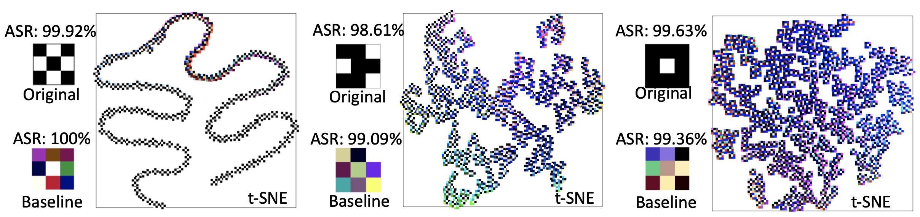
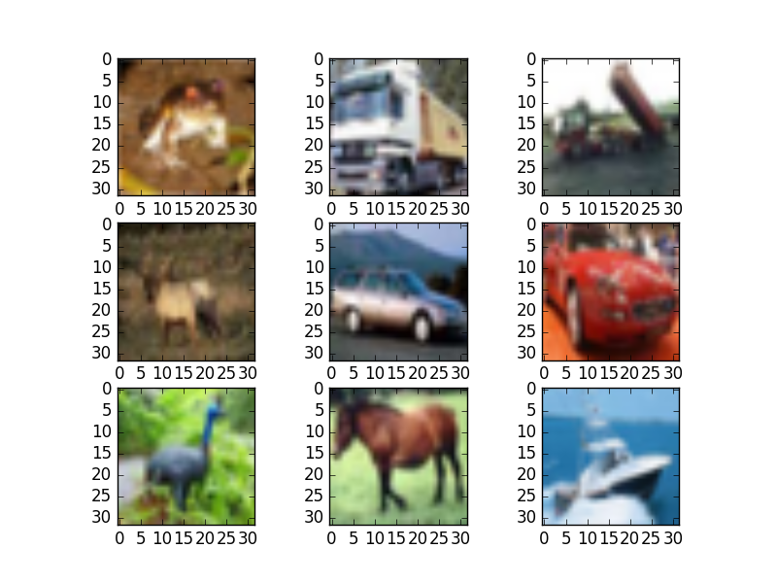

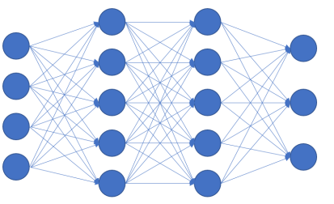
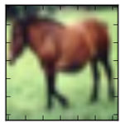
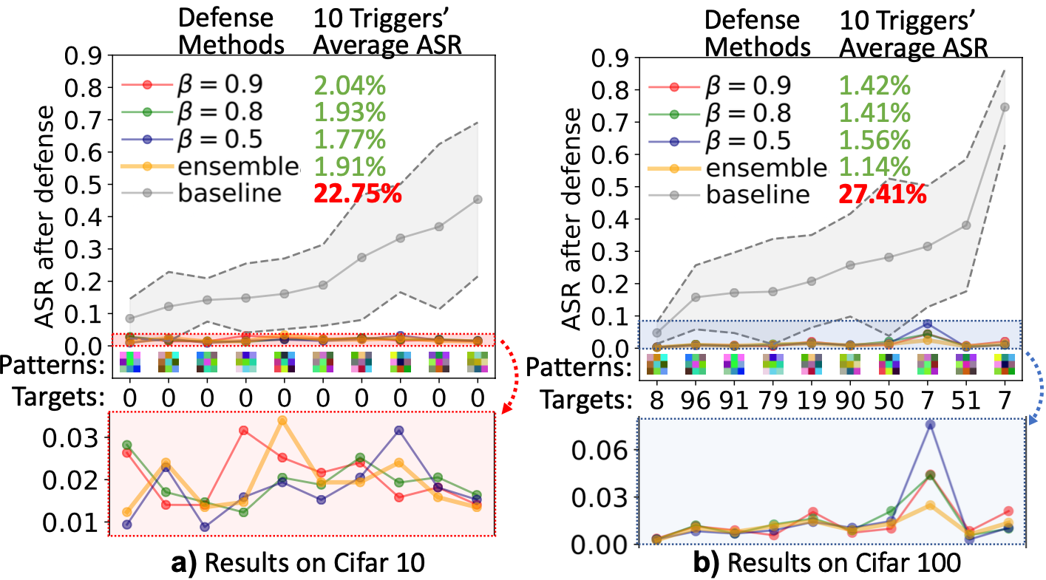
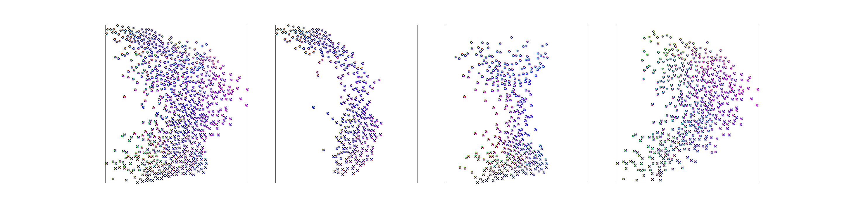


















Defending Neural Backdoors via Generative Distribution Modeling
Ximing Qiao*, Yukun Yang*, Hai Li ECE Department, Duke University, Durham, NC 27708
*Equal contribution
Code available at http://github.com/xxxxxxxxxxxxxxxxx
Neural Backdoor Background
Max-Entropy Staircase Approximator
Backdoor Visualization
Neural Backdoor Attacks
Neural Backdoor Defenses
Reversed engineer the backdoor trigger
Apply the trigger to training data
Retrain the model with correct label
Typical distribution methods (GAN, VAE) fails due to the unobtainable groundtruth dataset
Entropy maximization can explore a single constraint set
Use staircase approximation to model the entire distribution
Dataset: CIFAR10
Trigger size: 3×3
Trigger type: black-white
Baseline: pixel space SGD
Visualization: t-SNE
frog
dog
truck
dog
Step1.
Backdoor Injection
Data Poisoning
Set of Valid Triggers
Set of Valid Triggers
Trigger
Max-entropy model
automobile
Model
DNN
dog
Training
Probability density
Noise
$$β_{3}$$
(target class: dog)
$$W$$
$$G_{3}$$
$$χ_{3}$$
$$f_{ }$$
When
$$N=3$$
Noise
$$β_{2}$$
Without trigger
Backdoored
DNN
horse
Step2.
Backdoor Triggering
$$G_{2}$$
$$χ_{2}$$
With trigger
dog
ASR
Pixel space
P($χ$)
Noise
$$β_{1}$$
$$F=g◦f$$
1
$$G_{1}$$
$$χ_{1}$$
Ensemble
with$(γ_{1},γ_{2},γ_{3})$
Backdoor Defense
Pixel space
Pixel space
Retrain the model with the reversed trigger distribution gives more robust defense (baseline: single reversed trigger)
CIFAR10 with black-white triggers
CIFAR10/100 with random color triggers
ASR: Attack Success Rate
Implementation
Estimate ASR by cross-entropy loss (Testing Function)
Estimate entropy by [1] (Statistics Network)
Generate backdoor trigger by a neural network (Generator)
For a given $β_{i}$, train Generator $G_{i}$ to minimize
$F$: testing function. $\hat{I_{i}}$: estimated mutual information (MI)
$z$: Gaussian input noise. $α$: regularization strength
Backdoor Distribution Hypothesis
Deficiency of existing defenses
Hypothesis: backdoors as distributions
Loss
Loss
Reversed
Trigger
Original
Trigger
Reversed
Trigger
Original
Trigger
Pixel Space
Pixel Space
Backdoored
DNN
Original trigger
$$L=\max\left(0,β_{i}−F∘G_{i}\left(z\right)\right)−α\hat{I_{i}}\left(G_{i}\left(z\right);z\right)$$
dog
People used to consider a Backdoor as…
Estimated ASR
Estimated MI
Backdoored
DNN
dog
Penalty on ASR<$β_{i}$
Entropy regularization
dog
…
dog
dog
Valid trigger distribution
What a Backdoor really is…
[1] Belghazi et al., Mine: mutual information neural estimation, ICML 2018

